Slide 1

One day of python
Saintcon 2022
Notes:
<number>

Slide 2

Module 0
Front matter

Slide 3
whoami
Long time software engineer
More recently bridged to Application Security
Third time presenting at Saintcon
Michael Fischer / Senior Director, Information Security +1-612-503-4271 / michael.fischer@arcticwolf.com Arctic Wolf Networks 8939 Columbine Road, Eden Prairie, MN 55347
https://arcticwolf.com

Slide 4
Disclaimers
The views presented are my personal views and do not reflect that of my employer
No guarantees that this course will teach you everything you need to know about Python
Actually can pretty much guarantee that this is not the case
But you will have fun and this should address most of the googling that you would do if you were trying this on your own.

Slide 5

AppSec @Saintcon
You have an Appsec Program, right? Tues 2:30
Application Security Maturity Model for Software
Companies – Kenton McDaniel – Wed 11:30
Code Secure Without Becoming a Hacker – Alton Crossley – Thu 11:00
Putting the Sec back into DevSecOps – Andrew Hall – Fri 10:00
Notes:
Learn how to write a regex to filter malicious input
Learn how to fix vulnerabilities in the juice shop
how to do a pull request
Informal AppSec challenge….

Slide 6
Mood setting
Launch Python3 – typically typing ‘python3’ in the terminal and hit enter
You should see a >>>> prompt
Type ‘print(‘hello world’) and press enter.
‘hello world’ should be presented back to you on the screen
Congratulations! You have run your first python program

Slide 8
Agenda
Morning Session - Basics
Getting started
Data types and Control structures
Functions and decorators
Useful Python functions
Afternoon Session
Working from the command line
Working with data files
Working with the internet
More

Slide 9

https://saintcon.org/hackerschallenge/#precon

Slide 10
Module 1
Start your engines

Slide 11

Step 1
Front face of coin
No need for Python
5
6
4
1
2
3

Slide 12


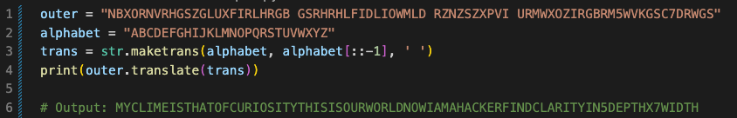
Steps 2
Outer circle
Notes:
MY CLIME IS THAT OF CURIOSITY THIS IS OUR WORLD NOW I AM A HACKER FIND CLARITY IN 5 DEPTH X 7 WIDTH

Slide 13
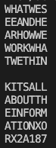
Steps 2 - 4
Inner circle
I AM A HACKER FIND CLARITY IN 5 DEPTH X 7 WIDTH
WEAWT
HEROW
AAHRE
TNOKT
WDWWH
EHWHI
SEEAN
KAEAR
IBITX
TONI2
SUFOA
ATON1
LTRX8
LHMO7
WEAWTHE
ROWAAHR
ETNOKTW
DWWHEHW
HISEEAN
KAEARIB
ITXTONI
2SUFOAA
TON1LTR
X8LHMO7
Notes:
What we see and hear
How we work
What we think
Its all about the information
Xor x2a187

Slide 14
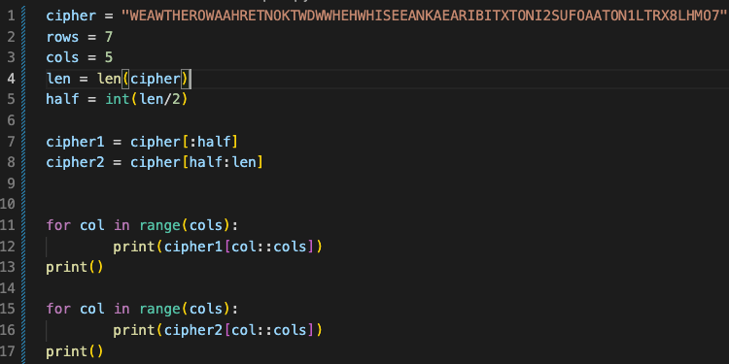
Steps 2 - 4
Inner circle
Notes:
What we see and hear
How we work
What we think
Its all about the information
Xor x2a187

Slide 15
Steps 3
Inside text
A little bit more work in
Python than we should see here.
https://www.dcode.fr/xor-cipher
Notes:
XOR Cipher

Slide 16
Basic Terminology
Term | Meaning
variable | A variable is just a named memory location that points to an object
function or method | A set of statements that are grouped to gather to enable reusability. A method is a function that is associated with a class.
object | A class is a template for an object. It defines the functions and properties that describe an objects behavior
class | A class is a template for an object. It defines the functions and properties that describe an objects behavior.
module | A python file that contains one or more function which as intended for reuse
package | A directory that contains Python module(s). The directory should contain an __init__.py which can have any or no implementation.
library | Sometimes used to describe a package but for the purposes of this tutorial it will mean the Python standard library.
Iterator, iterable and iteration | Iteration is the repetition of a process. An iterator is something that can iterate or is iterable.

Slide 17
Making a comment
Not to useful in the interactive shell but invaluable in scripts
# python
Anything from
It is a myth that ‘’’ or “”” can denote the beginning and end of a multi-line comment. What this does is create a multi-line string. If it is the first line of a module, function, class, or method it becomes the __doc__ for the object.

Slide 18
Basic Types
Type | Description | Notes
str | Represents a string of literal characters | msg = 'hello world'
bool | used to represent True (1) or False (0) | done = True or done = bool(1)
int | A whole number | x = 5
float | A fractional number | pi = 3.14159265359
tuple | A sequence of immutable Python objects. Similar to lists but cannot be changed. | Top10 = ('Injection', 'Broken Authentication’, 'Sensitive Data Exposure', ...)

Slide 19
Basic Types
Type | Description | Notes
list | A sequence of mutable Python objects. | Top10 = ['Injection', 'Broken Authentication','Sensitive Data Exposure', ...]
range | An immutable sequence based on the values passed during initialization. | range(1,10)
set | A sequence of unique Python objects. | Top10 = set(['Injection', 'Broken Authentication','Sensitive Data Exposure', ...])
dictionary | A collection of key:value pairs | dict = ['Key':'Value', 'Name': 'Bob']
file | An object that represents a file | file = open('filename', 'r')

Slide 20
Naming Conventions 1 (per Python Documentation)
General
Avoid using names that are too general or too wordy. Strike a good balance between the two.
Bad: data_structure, my_list, info_map, dictionary_for_the_purpose_of_storing_data_representing_word_definitions
Good: user_profile, menu_options, word_definitions
Don’t be a jackass and name things “O”, “l”, or “I”
When using CamelCase names, capitalize all letters of an abbreviation (e.g. HTTPServer)

Slide 21
Naming Conventions 2 (per Python Documentation)
Packages
Package names should be all lower case
When multiple words are needed, an underscore should separate them
It is usually preferable to stick to 1 word names
Modules
Module names should be all lower case
When multiple words are needed, an underscore should separate them
It is usually preferable to stick to 1 word names

Slide 22
Naming Conventions 3 (per Python Documentation)
Classes
Class names should follow the UpperCaseCamelCase convention
Python’s built-in classes, however are typically lowercase words
Exception classes should end in “Error”
Global (module-level) Variables
Global variables should be all lowercase
Words in a global variable name should be separated by an underscore

Slide 23
Naming Conventions 4 (per Python Documentation)
Instance Variables
Instance variable names should be all lower case
Words in an instance variable name should be separated by an underscore
Non-public instance variables should begin with a single underscore
If an instance name needs to be mangled, two underscores may begin its name
Methods
Method names should be all lower case
Words in an method name should be separated by an underscore
Non-public method should begin with a single underscore
If a method name needs to be mangled, two underscores may begin its name

Slide 24
Naming Conventions 5 (per Python Documentation)
Method Arguments
Instance methods should have their first argument named ‘self’.
Class methods should have their first argument named ‘cls’
Functions
Function names should be all lower case
Words in a function name should be separated by an underscore
Constants
Constant names must be fully capitalized
Words in a constant name should be separated by an underscore

Slide 25
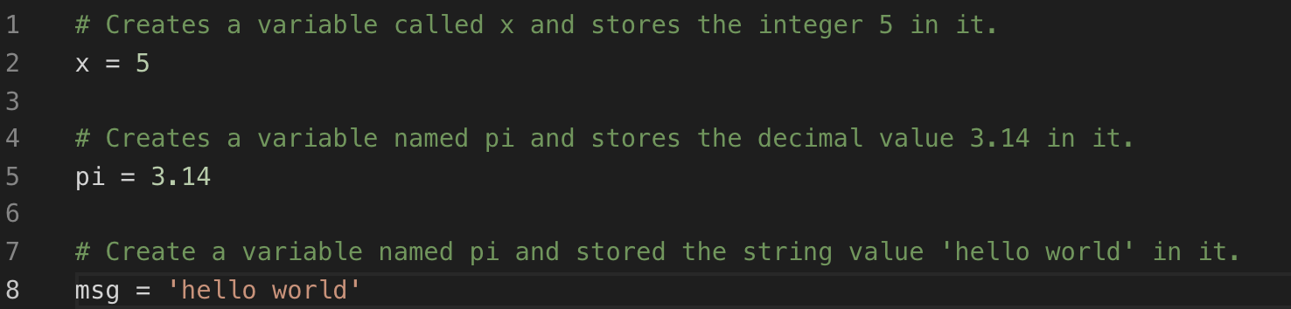
Creating Objects
Creating objects is simple in Python. You create a variable and assign it the value. Some examples you have already seen

Slide 26
Learning About Objects
Python has some built in functions that can help you learn about objects in the interactive shell
help() - Given a object will describe the object by displaying the Docstrings associated with the object and the methods contained within.
dir() - given an object, it will return the methods and attributes of the object.
type() -given an object, it will return the type of the object as represented by the __name__ attribute on the object

Slide 27
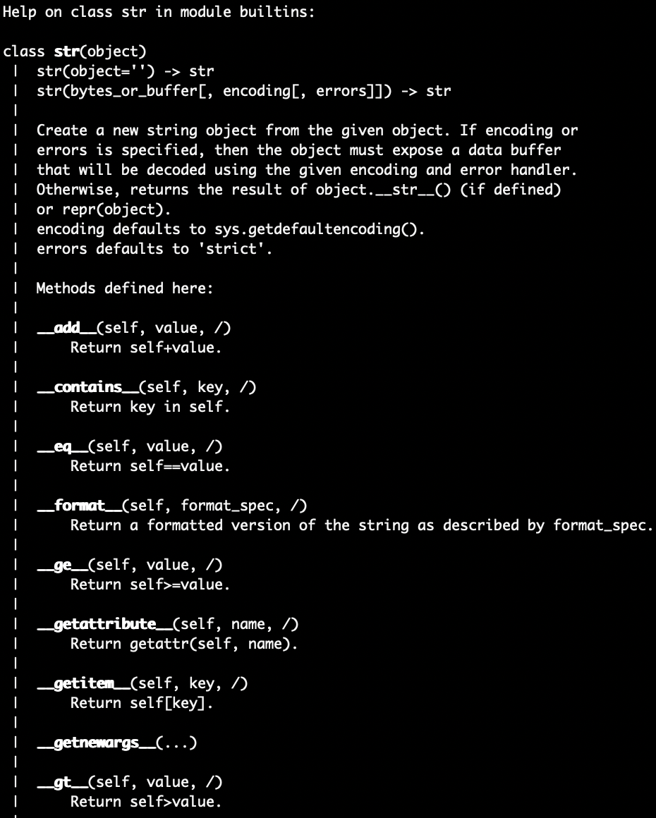
help example
Launch Python3 from the terminal
Type `help(str()`

Slide 28
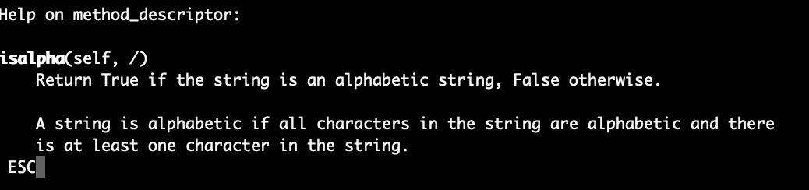
Help example - continued
In the interactive shell still
Type help(str.isalpha)

Slide 29
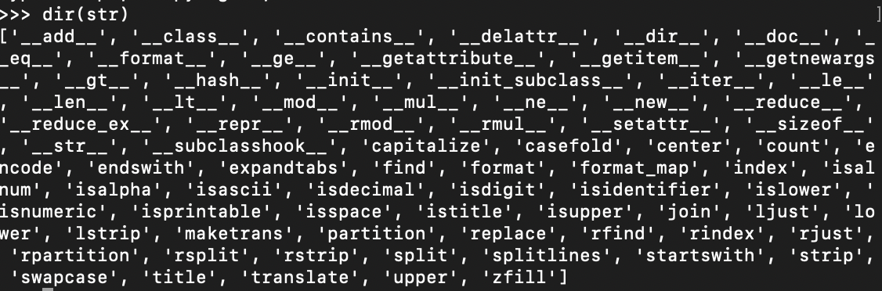
dir example
Notes:
we will learn more about **magic methods** as the day progresses. For now the only important thing to know is that the start and end with double underscores. You may also hear them referred to a **dunder** methods. This is not a reference to the Dunder Mifflin Paper company but double underscore. It is usually used when communicating a magic methods by name as "dunder" rolls of the tongue easier.
<number>

Slide 30
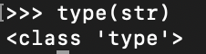
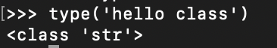
Type example

Slide 31
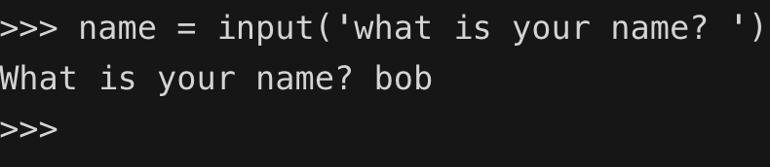
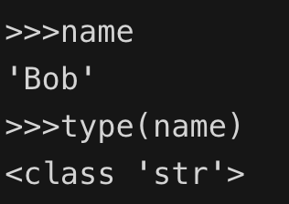
User input
Most basic form of input: Keyboard input
Easy to capture using input()
Notes:
Despite its simplicity this is fairly busy
Create a variable named name and store input from it.
Later in the session we display that value and do some introspection on it.
<number>

Slide 32

Hello world (Python Interactive)
Let’s expand hello world. That was too easy. Let’s try using what we learned to ask the user for his name and customize the response.
Launch Python3 – typically typing ‘python3’ in the terminal and hit enter
From the interactive prompt type the following:
>>>> name = input(‘what is your name? ‘)
print(‘hello ‘ + name + ‘. It is nice to meet you?’)

Slide 33
Module 2
All the math you need to know - sometimes

Slide 34
Conditionals
Ultimately decisions in conditionals break down into true/false, yes or no, 1 or 0.
The can be added together with Boolean algebra or logical operators
AND | True is both are True
OR | True if one of the other is True
XOR | True if one or the other is True, but not if both
NOT | (Unary) Invert the current result
A | B | AND | OR | XOR | NOT A
True | True | True | True | False | False
True | False | False | True | True | False
False | True | False | True | True | True
False | False | False | False | False | True

Slide 35
Comparison Operators
Operator | Symbol | Description | Example
Addition | + | Adds the two addends together to provide the sum | sum = addend1 + addend2
Subtraction | - | Subtracts the subrtahend from the minuend to provide the difference | difference = minuend - subtrahend
Multiplication | * | Multiplies the multiplicand by the multiplier to return the product | product = multiplicand * multiplier
Division | / | Divides the dividend by the devisor to return the quotient | quotient = dividend / devisor
Notes:
<number>

Slide 36
Comparison Operators continued
Operator | Symbol | Description | Example
Modulus | % | represents the remainder of the result of division with the quotient has been determined | modulus = dividend % devisor
Exponent | ** | Raises the base by the value specified in the exponent to return the power | power = base ** exponent
Floor Division | // | Similar to division but with the result round down to the next lower integer value | quotient = dividend // divisor

Slide 37
Assignment Operators
Symbol | Description | Longhand | Shorthand
/= | Divides the left operands with the right operand and stores the result in the left operand | x = x / y | x /= y
%= | Performs the modulo function on the left operand by the right operand and stores the result in the left operand | x = x % y | x %= y
**= | Raises the left operand to the exponent specified in the right operand and stores the result in the left operand | x = x ** y | x **= y
//= | Divides the left operands with the right operand and stores the result in the left operand | x = x // y | x //= y

Slide 38
Assignment Operators Continued
Symbol | Description | Longhand | Shorthand
= | Assigns the value from the right hand side to the left hand side | x = y | NA
+= | Adds the right operand to the left operand and stores the result in the left operand | x = x + y | x += y
-= | Subtracts the right operand from the left operand and stores the result in the left operand | x = x - y | x -= y
*= | Multiples the left operand with the right operand and stores the value in the left operand | x = x * y | x *= y
Notes:
<number>

Slide 39
Comparison Operators
Operator | Symbol | Description
Equal To | == | Returns True if the two values are equal
Not Equal | != OR<> | Returns True if the two values are not equal
Greater Than | > | Returns True if the first value is greater than the second value
Less Than | < | Returns True if the first value is less than the second value
Greater Than or Equal To | >= | Returns True if the first value is greater than or equal to the second value
Less Than or Equal to | <= | Returns True if the first value is less than or equal to the second value

Slide 40
Bitwise operators
Operator | Symbol | Description
Binary AND | & | Copies a bit to the result if it is set in bother operands
Binary OR | | | Copies a bit to the result if it is set in either operand
Binary XOR | ^ | Copies the bit if it is set in one operand but not the other
Binary Ones Complement | ~ | A unary operator that 'flips' the bits that are set
Binary Left Shift | << | The left hand operands are moved to the left by the number of bits represented on the right hand side
Binary Right Shift | >> | The left hand operands are moved to the right by the number of bits represented on the right hand side

Slide 41
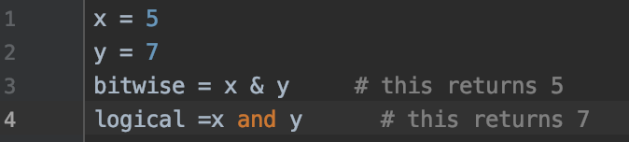
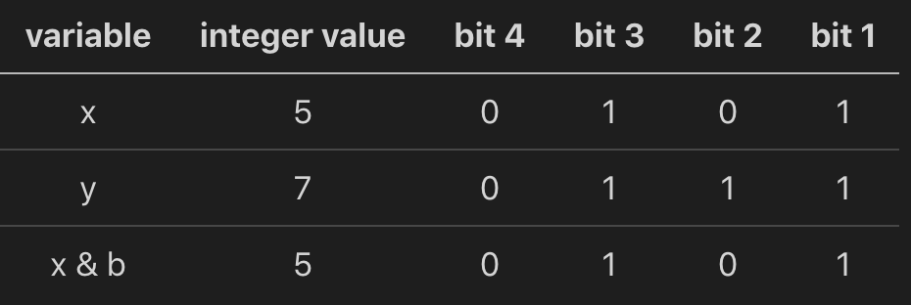
Differences between logical and bitwise operators
Notes:
<number>

Slide 42
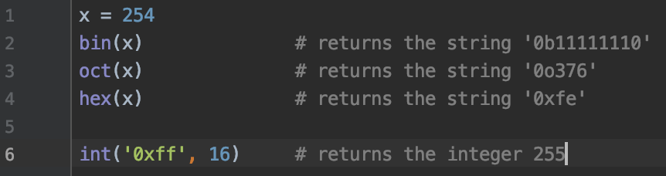
Converting integers to other types
bin(n) - Convert an integer to a string of binary digits
oct(n) – Convert an integer to a string of octal digits
hex(n) - Convert an integer to a string of hex digits
int(s, n) – Convert a string to an integer of n radix.
Notes:
if you specify 0 as the base then the Python runtime will attempt to infer the base from the encoding in the string.
<number>

Slide 43
Bitwise Truth Table
A | B | A & B | A | B | A ^ B
1 | 1 | 1 | 1 | 0
1 | 0 | 0 | 1 | 1
0 | 1 | 0 | 1 | 1
0 | 0 | 0 | 0 | 0

Slide 44
Conditionals
AKA the if statement
# do something if a condition is true
if expression:
statements
#do one or the other
if expression:
statements
else:
statements
if expression:
statements
elif expression:
statements
...
else:
statements
#nested
if expression:
if another expression:
statements
Notes:
<number>

Slide 45
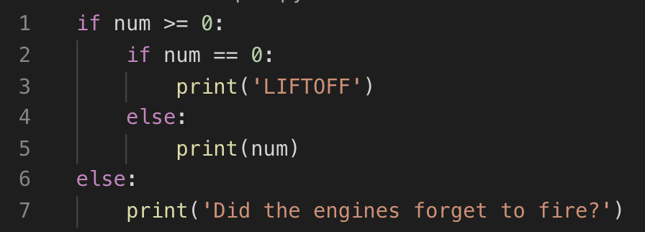
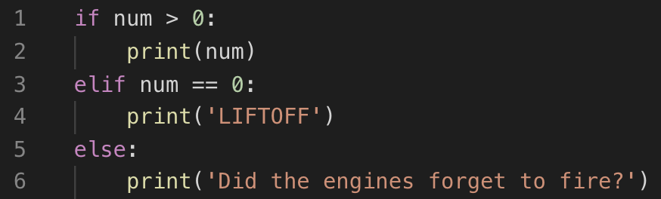
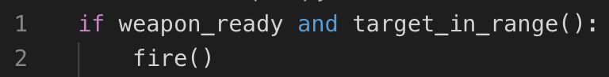
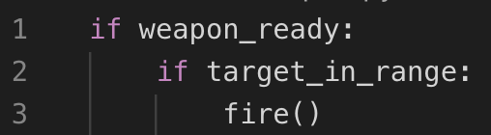
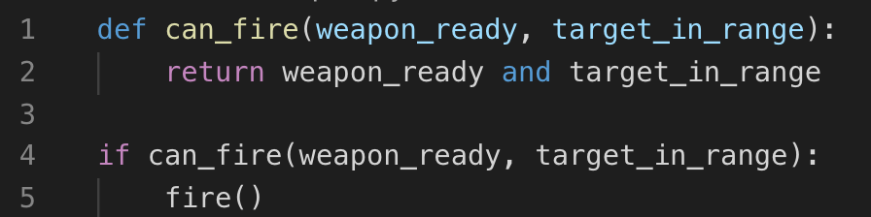
Is nested necessary

Slide 46
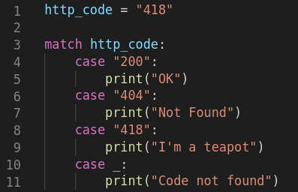
New in Python 3.10
Structural pattern Matching
Feature is more capable than other languages case statements
No match, no actions taken
Underscore in the last case is a wildcard (optional)

Slide 47
Conditional Coding Exercise

Slide 48
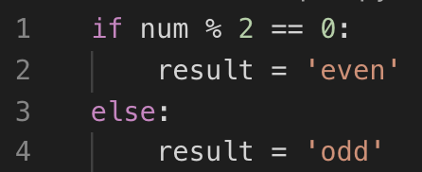
Ternary operator
Notes:
If you are familiar with other programming languages this syntax may be a bit odd to you.
<number>

Slide 49
REPETITION REPETITION IN PYTHON
Simplified in Python compared to other languages
Two looping constructs
for
while
Notes:
For - chosen when you have an an object that is iterable that you want to iterate through and perform an operation on each item
While - allows you to continue a loop until a condition is meet
<number>

Slide 50
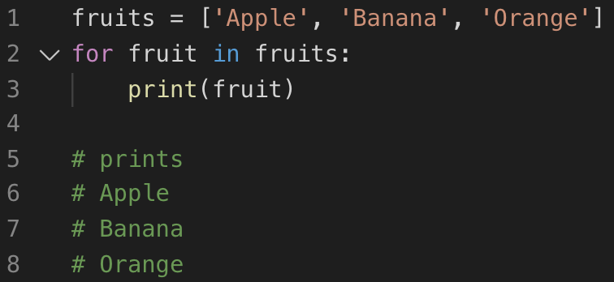
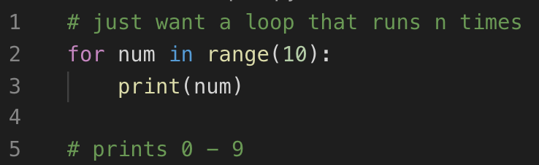
For loop examples

Slide 51
For loop exercise

Slide 52
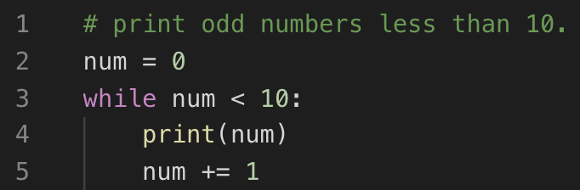
While Loop
Allows you to continue a loop until a condition is met.
while expression:
statements
Notes:
This is a quick in depth look at decision making and looping. It is good to know but shortly we will see some more Pythonic ways to accomplish this.
<number>

Slide 53
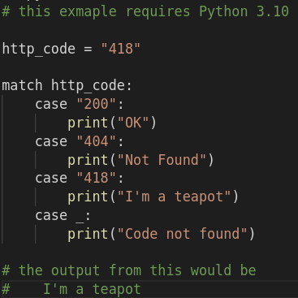
Structural Pattern Matching
Now able to create a case like statement in python.
More powerful than standard case statement
PEP-636 Provides more details on advanced usages.
match expression:
case [action]:
statements
…
case _:
statements
Notes:
This is a quick in depth look at decision making and looping. It is good to know but shortly we will see some more Pythonic ways to accomplish this.
<number>

Slide 54
Module 3
Strings and other sequences in Python

Slide 55
Sequence Types
Strings – a sequence of characters
Ranges – can be thought of as a sequence of integers
List - an ordered mutable collection of Python objects
Tuple – Similar to a list but immutable
Set – Similar to a list but only contains unique elements
Dictionary - an unordered, mutable, indexed collection of key value pairs.

Slide 56
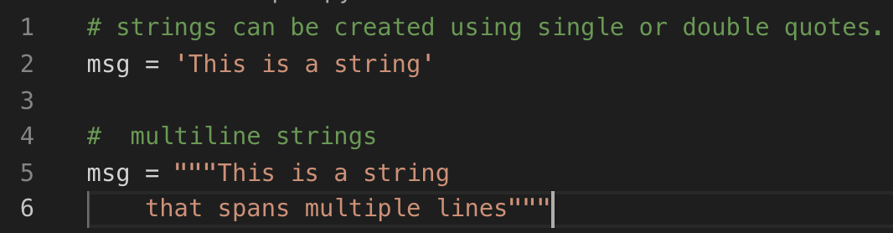
strings
Just a sequence of characters
Changed significantly between Python 2 and Python 3

Slide 57
Common operations
Operation | Example | Result
in | x in s | True if x is contained within s
not in | x not in s | False if x is contained within s
+ | s + t | will concatenate s and t
* | s * n or n * s | will add s to itself n times
len | len(s) | will return the length of s
min | min(s) | the minimum value of s. Might not be too terribly useful on a string
max | max(s) | the maximum value of s. Might not be too terribly useful on a string
chr | chr(n) | Converts an integer to a string
str | str(0) | returns a string representation of an object

Slide 58
Common String Methods
Method | Meanings
lower() | Converts to lower case
upper() | Converts to upper case
strip() | Removes leading and trailing spaces from string. lstrip() and rstrip() will strip left and right respectively
split() | Will take a string a return a list based on the delimiter
join() | The opposite of split(). Will create a string from a list using the string as delimiter

Slide 59
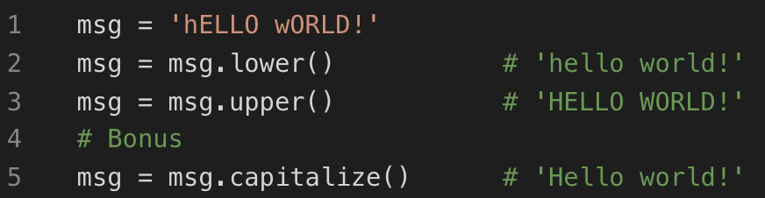
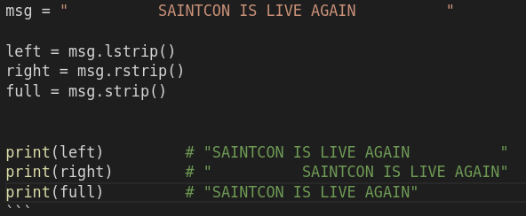
Common Methods Example

Slide 60
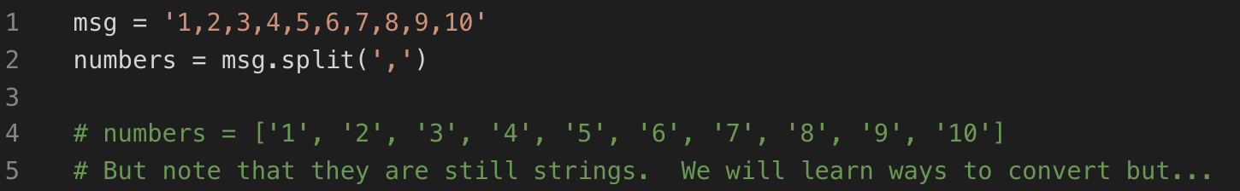
Common Methods Example

Slide 61
Slicing Strings
Operation | Example | Result
index | s[i] | will return the ith item in s
slice | s[i:j] | returns a slice of s starting at index i and up to but not including j
stride | s[i:j:k] | returns a slice of s starting at index i and up to but not including j stepping by k
index | s.index[x[, i[, j]]] | index of the first occurrence of x in s (at or after index i and before index j)
count | s.count(x) | total number of occurrences of x in s
encode | s.encode('utf-8') | returns a UTF-8 formatted version of s. This will return a bytes array that can be transformed back with the bytes.decode() method

Slide 62
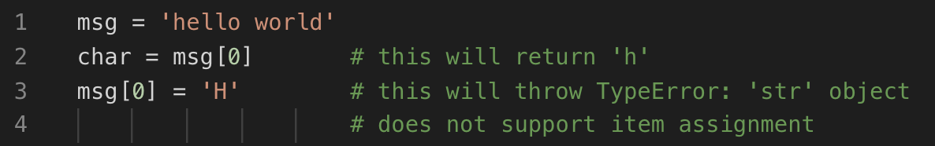
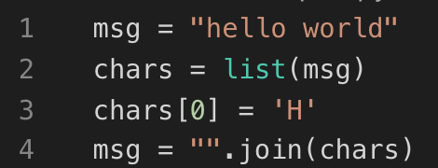
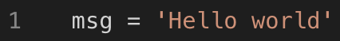
Complete documentation can be found at Python Documentation
Since strings are immutable
The following will error
To fix you need to create a new string with the results
Notes:
there are some things that you could do in other languages that wont work in Python. For example:
<number>

Slide 63
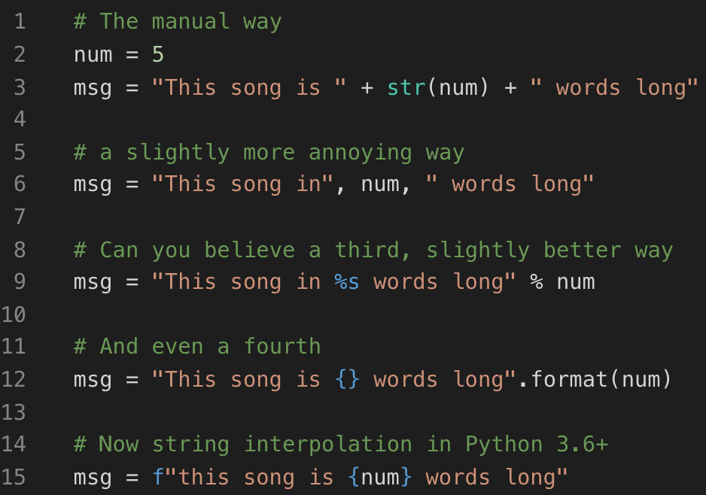
Formatting Strings
Multiple ways to format strings
The newer f-string method is the most powerful as it allows expressions between the brackets
String formatting is powerful and has a dedicated mini language powering it.
Notes:
sting.format() is was what was vogue when I started to learn Python.
However, you got to admit it is cool to have to deal with f-strings. Okay, so that really stands for Formatted String Literal.
<number>

Slide 64
Format Specifiers
[[fill]align][sign][#][0][width][grouping_option][.precision][type]
part | meaning
fill | Any character fill with. Default space
align | Aligns the output according to width
sign | Indicates whether a sign symbol should be present
# | Alternate form should be used for conversion
part | meaning
width | Minimum field length
grouping option | Thousand separator – underscore or comma
.precision | # of digits after the decimal point
type | How that data should be presented

Slide 65
Alignment | Meaning
< | Left -aligned
> | Right aligned
= | Forces padding after sign but before digits
^ | Center output
Sign | Meaning
+ | Sign for positive and negative numbers
- | Default. Only negative
space | Leading space on positive. Symbol on negative
Notes:
Alignment is in theb
<number>

Slide 66
Formatting SpecifieRs
Symbol | Type | Meaning
‘s’ | string | String format. This is the default type for strings and may be omitted.
‘b’ | integer | Binary format. Outputs the number in base 2.
‘c’ | integer | Character. Converts the integer to the corresponding unicode character before printing.
‘d’ | integer | Decimal Integer. Outputs the number in base 10. Default if omitted
‘o’ | integer | Octal format. Outputs the number in base 8.
‘x’ | integer | Hex format. Outputs the number in base 16, using lower-case letters for the digits above 9.
‘X’ | integer | Hex format. Outputs the number in base 16, using upper-case letters for the digits above 9.
‘n’ | integer | Number. This is the same as 'd', except that it uses the current locale setting to insert the appropriate number separator characters.

Slide 67
Formatting Specifiers
Symbol | Type | Meaning
‘e’ or ‘E’ | float | Exponent notation. Prints the number in scientific notation using the letter ‘e’ or ‘E’ to indicate the exponent. The default precision is 6
‘f’ or ‘F’ | float | Fixed-point notation. Displays the number as a fixed-point number. The default precision is 6. Difference is in capitalization of nan and inf
’g’ or ‘G’ | float | General format. Rounds the number to specfied significant digits and then formats the result in either fixed-point format or in scientific notation, depending on its magnitude.
‘n’ | float | Number. This is the same as 'g', except that it uses the current locale setting to insert the appropriate number separator characters.
‘%’ | float | Percentage. Multiplies the number by 100 and displays in fixed ('f') format, followed by a percent sign.
None | float | Similar to 'g', except that fixed-point notation, when used, has at least one digit past the decimal point. The default precision is as high as needed to represent the particular value. The overall effect is to match the output of str() as altered by the other format modifiers.

Slide 68
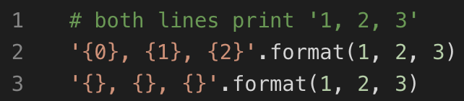
Examples
Notes:
<number>

Slide 69
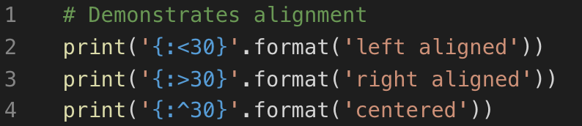
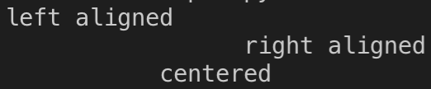
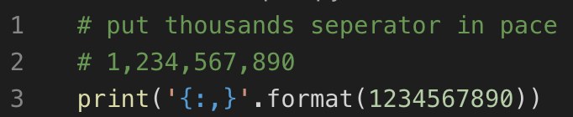
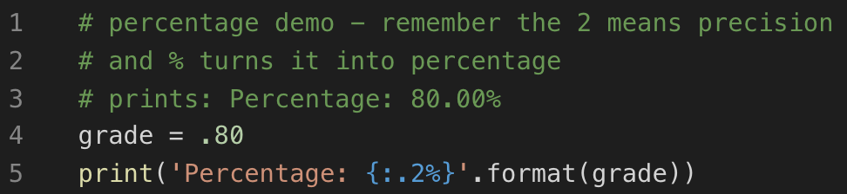
Examples
Notes:
<number>

Slide 70
Formatting strings exercises

Slide 71
Module 4
zip(), map(),
filter(), and reduce()

Slide 72
Some terms that will help with this section.
Iterate is defined in the dictionary as 'perform repeatedly.’
An iterable is anything that can be looped over.
An iterator is an object with state that remembers where it is in during an iteration.

Slide 73
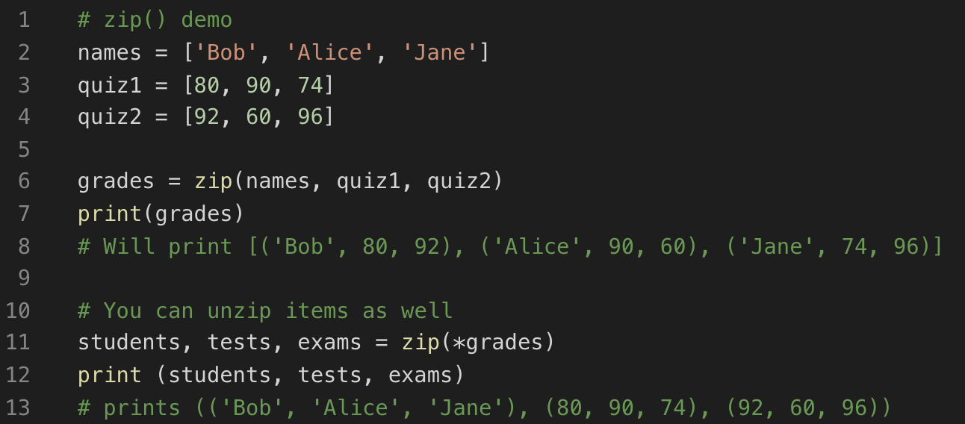
Zip()
Notes:
Method that can combine multiple iterables into one structure.
This structure is an iterable of tuples.
If you pass in a single iterable you will get a list of tuples.
<number>

Slide 74
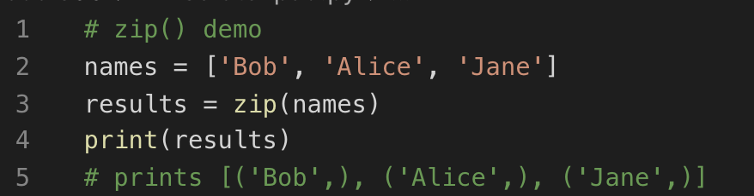
Zip()
Notes:
If you pass in a single iterable you will get a list of tuples.
<number>

Slide 75
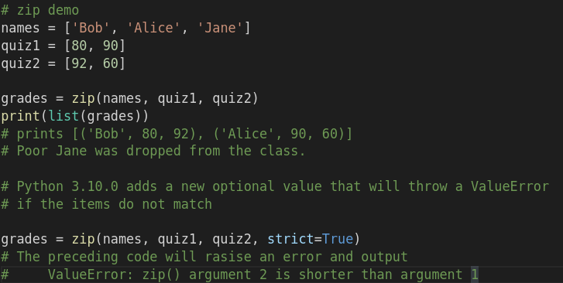
Zip()
Notes:
One thing to note is that the returned iterator will stop when the shortest iterables passed into it is reached.
<number>

Slide 76
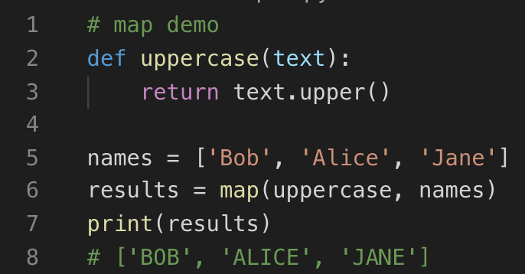
Map()
Method that will call a specified function with each element in an iterable. The results returned from the map() function is a list containing the results the function on each item of the iterable.

Slide 77
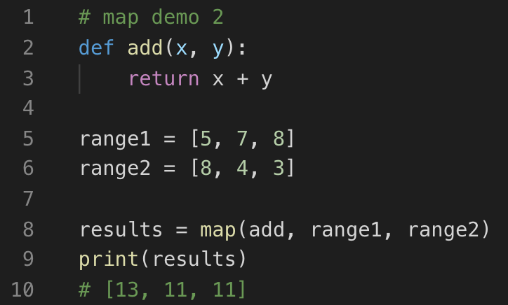
Map()
Working with multiple arguments is possible but tedious. Here is an example without any special considerations. We will learn a better way later.

Slide 78
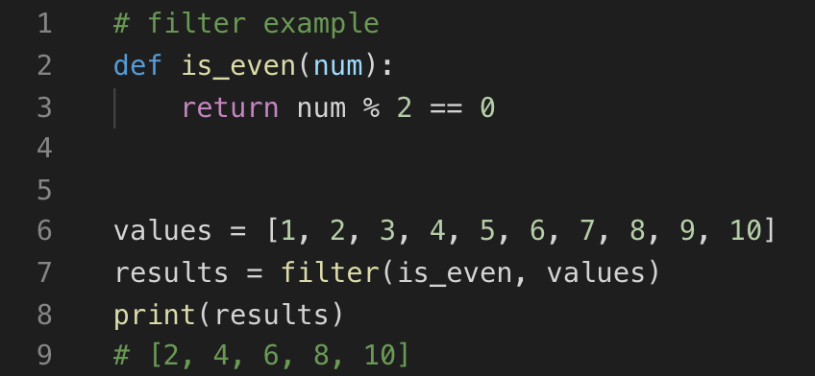
Filter()
Method that will extract values that meet criteria from an iterable.
The resulting list returned from this will return an iterator that contains the values that returned true.
Notes:
Similar to the map() function, filter() will take an function to take an iterable and apply it to the iterable.
The difference is that this function should return either True or False.
<number>

Slide 79
Reduce()
Method that will perform cumulative tasks on an iterable. Where map() applies individually to each item passed into the iterable, reduce() will:
During the first step it will take the first two elements and apply it to the function.
For the second iteration it will take the results of the first call and the third item in the iterable and call the function.
The process continues until there are no more items and the final result is returned.
Notes:
This function may allow you to do some things that you thought were possible with map().
<number>

Slide 80
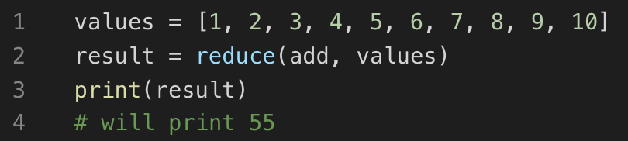
Map example

Slide 81
Module 5
Lambdas and List
Comprehensions
Notes:
Now it is time to start thing about making our scripts more reusable. In this module we will look at Functions, Classes, Modules, and Libraries. Before we started on those we will want to look into Scope and how it affects variables.
<number>

Slide 82
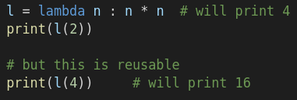
Lambdas
Lambdas are small anonymous functions
These a anonymous functions are defined by the *variables* they require and the *expression* that represents the function.
l = lambda a, b, c: a + b + c
# will print 9
print(l(2, 3, 4))
Notes:
When the code above executes l represents a lambda that will double values that it is called with. It is simple to add more variables to the lambda as demonstrated in the following snippet.
Transition
them in your own. Some things to keep in mind is that lambdas have a strange and difficult syntax that require that you think in a different manner and provide a really descriptive 'lambda' instead of a function name in any Traceback. Unless you are writing a framework or working with a framework method that requires them.
<number>

Slide 83
def square(n):
return n ** 2
numbers = [1, 2, 3, 4, 5, 6, 7, 8, 9, 10]
# procedural code
squares = []
for n in numbers:
squares.append(square(n))
# using map
squares = list(map(lambda x: square(x), numbers))
# list comprehension
squares = [square(n) for n in numbers]
squares = [n**2 for n in numbers]
Notes:
A list comprehension is Python syntax to creates a new list from other iterables. Let's recall the square function that was used earlier to see how list comprehensions can clean up our code
TRANSITION to show last line
<number>

Slide 84
List Comprehension for a sublist
numbers = [1, 2, 3, 4, 5, 6, 7, 8, 9, 10]
even_squares = [square(n) for n in numbers if n % 2 == 0]
# while print [4, 16, 36, 64, 100]
print(even_squares)

Slide 85
portion | purpose
even_squares | the variable that will hold the results of the list comprehension
[ | marks the beginning of the list comprehension
square(n) | the expression to perform on the list
for n in numbers | for variable in originating list
if n % 2 == 0 | An optional predicate to sort the list
] | marks the end of the list comprehension
Notes:
As can be seen the syntax for list comprehensions my be a little difficult to get a handle on.
<number>

Slide 86
Module 6
Functions and Classes
Notes:
Now it is time to start thing about making our scripts more reusable. In this module we will look at Functions, Classes, Modules, and Libraries. Before we started on those we will want to look into Scope and how it affects variables.
<number>

Slide 87
Scope
Also referred to as namespace
A container for mapping names to objects whether they are variables, functions, or classes
Four Scopes in Python
Local
Enclosing
Global
Built-in
Notes:
Before talking about functions lets talk about scope…
Scope is defined in a hierarchy search order where if a variable cannot be found in the local scope, the enclosing scope will be searched. Next, the the global namespace will be searched and finally the built-in scope. If a variable name was not found any an scope a NameError exception will be raised.
Modules also provide another level of scope, but more on that later
Local
Variables that are defined within a function or a class method are local in scope. Local variables can only be accessed within the function that they are defined in. If you try to access a local variable outside the scope that it is defined the script will raise a NameError. ex: NameError: name 'x' is not defined.
Enclosing
Enclosed can be the enclosing function. For instance if a function was defined within another function.
Global
Variables that are defined outside of a class or function are said to be in the global scope. They are global to the level of the executing script.
These variables can be access from anywhere. While this sounds powerful but it is a double edged sword. If the variable is mutable it can also be changed by anywhere as well. Global variables should be used with caution or not at all any anything beyond trivial scripts.
Built-in
These are variables that are predefined in Python.
<number>

Slide 88
Local scope DemoS
Notes:
local_scope.py
<number>

Slide 89
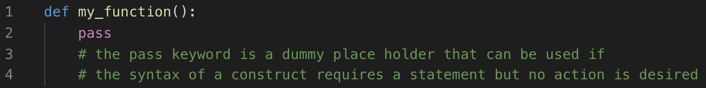
Functions
Simply allow you to create small reusable sections of code
Customizable through the use of parameters
Have the ability to return results if desired
Functions are defined by
the def keyword,
followed by the name of the function
some parameters and a colon.

Slide 90
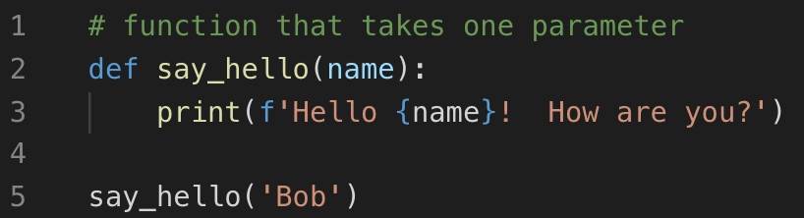
Example Function Definitions
Notes:
You can do a lot with functions without taking user input. However, by adding parameters it becomes possible to make functions dynamic. Without parameters, functions can only do the exact same thing over and over.
<number>

Slide 91
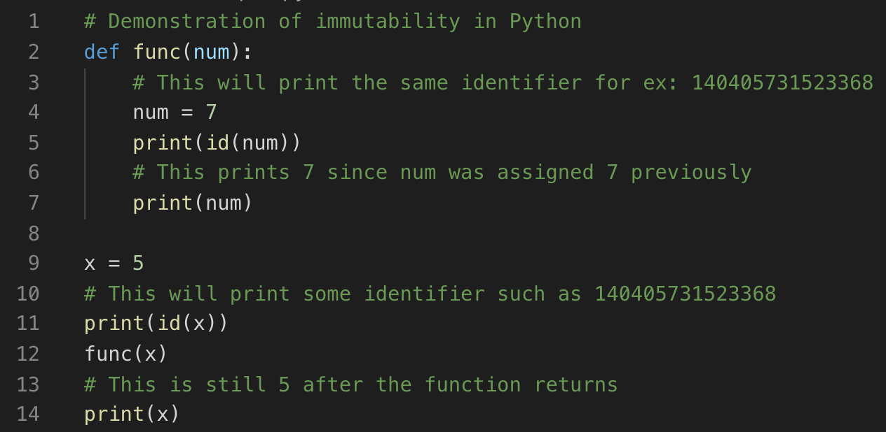
Functions and immutability
Notes:
In other languages parameters are either passed by reference or passed by value. Python takes another approach and parameters are passed by assignment. Everything in Python is an object. Objects can either be mutable or immutable. Immutable types include bool, int, float, tuple, and string. Mutable types ae list, set, and dict.
<number>

Slide 92
Functions and immutability
Notes:
In other languages parameters are either passed by reference or passed by value. Python takes another approach and parameters are passed by assignment. Everything in Python is an object. Objects can either be mutable or immutable. Immutable types include bool, int, float, tuple, and string. Mutable types ae list, set, and dict.
<number>

Slide 93
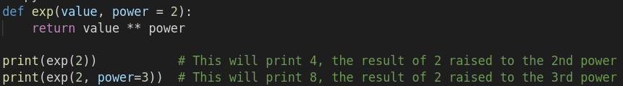
Named Parameters
Notes:
In other languages parameters are either passed by reference or passed by value. Python takes another approach and parameters are passed by assignment. Everything in Python is an object. Objects can either be mutable or immutable. Immutable types include bool, int, float, tuple, and string. Mutable types ae list, set, and dict.
<number>

Slide 94
*args
def dynamic_args(*args):
for arg in args:
print(arg, end = " ")
dynamic_args("Welcome", "To", "Python")
# This will print "Welcome To Python"
Notes:
There is a special syntax that allows you to pass in a variable number of parameters into a python method. One option is _*args_ and the other is _**kwargs_. _*args_ allows a variable number of arguments into a method.
**kwargs_ allows for a variable length of key and value pairs which will be passed into the function as a dictionary.
<number>

Slide 95
**kwargs
def dynamic_kwargs(**kwargs):
print(type(kwargs))
for key, value in kwargs.items():
print ("%s == %s" % (key, value))
dynamic_kwargs(first ='Welcome', mid ='To', last='Python')
# This will print
#
# first == Welcome
# mid == To
# last == Python
Notes:
But wait! There is more. if you buy now you can use this format for input as well. Consider the following code.
<number>

Slide 96
def standard_function(arg1, arg2, arg3):
print(f'arg1: {arg1}\targ2: {arg2}\targ3: {arg3}')
tuple_args = ('Welcome', 'To', 'Python')
dictionary_args = {"arg1": 'Welcome', "arg2": 'To', "arg3": 'Python’}
# Will print "arg1: Welcome arg2: To arg3: Python"
standard_function(*tuple_args)
# Will print "arg1: Welcome arg2: To arg3: Python"
standard_function(**dictionary_args)
Notes:
he caveat is that in either case it is important that the parameters match. In the first case, you need to have the exact number of parameters in the iterable that the function expects or you will receive a *TypeError*. You will also receive a *TypeError* in the keyword variation if the collection contains an unexpected key value or is missing one. Although, interesting things can happen if you use this convention both to call the function and as the parameters.
<number>

Slide 97
Let’s revisit function immutability
X
# Sadly this will not work the way
# we want it to since
# integers are immutable in Python
def swap(a, b):
a = a ^ b
b = a ^ b
a = a ^ b
x = 5
y = 6
swap(x, y)
print(x, y)
# Rats, x and y are still 5 and 6
# Neat Trick
x = 5
y = 6
x = x ^ y
y = x ^ y
x = x ^ y
# This will print 6 5 print(x,y)
Notes:
Slide has animation….
One of the favorite tricks that I learned back in my undergraduate tricks is something similar to the following.
Let’s go back and look at out other option with Functions …. Return values
<number>

Slide 98
Return Values
# This method does not behave correctly
def is_even(num):
if num % 2 == 0:
return True
# This will return True which we expect
print(is_even(4))
# This will return None which is
# probably not what we expect
print(is_even(5))
def sum(a, b):
return a + b
x = 5
y = 6
print(sum(x,y))
# prints 11
Notes:
Returning a method is as simple as specifying a value using the return keyword proceeding what should be returned.
The return value can be any valid Python expression. All methods return a value
Transition
How should we fix this? We need to make sure that all return paths return a value. There are a couple of ways that we can do this. First, by completing the original method
<number>

Slide 99
A Fixed Method
def is_even(num):
if num % 2 == 0:
return True
else:
return False
# A slightly cleaned up version
def is_even(num):
return num % 2 == 0
OR
Notes:
print(is_even(4)) # This will return True
print(is_even(5)) # This will return False
So how can this help with our SWAP method?
<number>

Slide 100
Swap Revisited
# Okay this version works but
# we will see it is rather silly
# in a second.
def swap(a, b):
a = a ^ b
b = a ^ b
a = a ^ b
return a, b
x = 5
y = 6
x, y = swap(x, y)
print(x, y)
# Better way
def swap(a, b):
return b, a
x = 5
y = 6
x, y = swap(x, y)
print(x,y)
Notes:
So what is the better way
TRANSITION
<number>

Slide 101
Classes in a nutshell
A python class is a template for putting together objects within Python.
Objects have attributes and functionality associated with it.
Classes are defined by the *class* keyword followed by the name of the class and a colon
By convention, class names start with an uppercase name.
Notes:
Object oriented programing is a class all on its own but we will keep well known object oriented principles in mind.
<number>

Slide 102
class Point:
x = 0
y = 0
# instantiating an object
point = Point()
print(point.x, point.y)
# prints 0, 0
point.x = 5
point.y = 7
print(point.x, point.y)
# prints 5, 7
def __init__(self, x, y):
self.x = x
self.y = y
Notes:
The attributes x and y in the `Point` class are actually associated with the class. Although it is important to note that the class recived that attribute as well. `Point.x` (as opposed to `point.x`) will still be zero at the end of the preceeding example.
Now we have an object with the ability to set the values for the x and y properties we defined. OO aficionados will scream that this breaks encapsulation. It is important to remember that classes are mutable in Python. The concept of private member variables is difficult but not impossible to achieve. However, that is a discussion for a later [topic](http://www.blog.pythonlibrary.org/2014/01/17/how-to-create-immutable-classes-in-python/). We can get a little closer to true OO but need to take a deeper look at methods in a class so that we can understand how objects are built in python.
TRANSITION
This is a little more object oriented bit the internal x, y are still accessible from an instance of the class.
<number>

Slide 103
Methods on Classes
Instance Method
Accessed through an instance of the class
Class Method
Access through the class name
Typically used to create a factory
Static Method
Allows grouping of methods that are related to the purpose of the class
My not be strictly necessary in Python.
From an OO perspective static methods might need to be another class
Or perhaps a module
Notes:
Object oriented programing is a class all on its own but we will keep well known object oriented principles in mind.
<number>

Slide 104


Instance Methods
X

Slide 105


INHERITANCE
Classes not only allow you to place data and methods in proximity to each other. But allows for deriving classes from others to gain functionality from other classes.
Notes:
Object oriented programing is a class all on its own but we will keep well known object oriented principles in mind.
<number>

Slide 106
Class and Static methods DEMO
Notes:
local_scope.py
<number>

Slide 107
Modules in a nutshell
A python module allows you to organize Python code.
However, you already know how to make a Python module.
It is any file that contains Python code, whether it be script, function, class or combination thereof.
A python module is defined by the name of the module.py.
For example, the module Saintcon would be in the file saintcon.py.
To use the module you need to the import statement.
Notes:
<number>

Slide 108
SEQUENCE.PY

Slide 109
Testing the sequence module
import sequences
print('Fibonacci\n')
for x in range(10):
print(x, sequences.fibonacci(x))
print("Squares\n")
for x in range(10):
print(x, sequences.squares(x))
print("Triangles\n")
for x in range(10):
print(x, sequences.triangles(x))

Slide 110
Packages in a nutshell
An extension to the modules framework
Simply a directory of modules and packages
All that is required to create a package is put an __init.py__ in the folder
Notes:
<number>

Slide 111
Module 7
Exceptions
Notes:
Now it is time to start thing about making our scripts more reusable. In this module we will look at Functions, Classes, Modules, and Libraries. Before we started on those we will want to look into Scope and how it affects variables.
<number>

Slide 112
Overview
Computer programs may run into problems from both errors and exceptions.
Errors are conditions that occur in programs that should not be recovered from.
The most likely error that you will see in Python is a SyntaxError.
However, a good Integrated Development Environment (IDE) will help identify those for you during the development process.
Exceptions, on the other hand, can be recovered from.
Exception handling in Python is more verbose than you might have seen in other languages with the addition of an optional else clause that is executed if no exception occurred during the *try* block.
The format of the *try* block is fairly simple.

Slide 113
Exception Handling
# example of the python exception handling construct
try:
# execute some code that could raise an exception
Except [<type> [as e]]:
# this code is executed if an exception occurs
pass
else:
# this code is executed if the try block is
# executed without exception
pass
finally:
# this code is executed after the try block,
# any exception block OR the else block
pass
Notes:
Rumor has it that the purpose of the else clause is that exception handling is more common in Python than other languages. It does make the code a little easier as the code in the else would otherwise need to be included in the try block after whatever line could have caused an exception.
- Different types of exception can be handled by repeating the except block
- You can just see different
<number>

Slide 114
Raising your own exception
# demo of raising an exception
raise Exception('This is my exception')
# Will produce the following Traceback - aka StackTrace
# Traceback (most recent call last):
# File "scratch.py", line 1, in <module>
# raise Exception('This is my exception')
#Exception: This is my exception
Notes:
It is also possible to *raise* an exception to signify that an exceptional condition has occurred. This allows the developer to control the flow of the program if necessary. Raising Exceptions have changed between Python 2 and 3 so we will only see the syntax for Python 3.
<number>

Slide 115
Detail hiding
# demo of raising an exception
try:
x = 5 / 0
except:
print('something went wrong')
# demo of raising an exception
try:
x = 5 / 0
except Exception as e:
print('something went wrong: \n' + str(e))
finally:
print('we made it to the end')
Notes:
If you run the example code on the screen. You will not see that the cause was a division by error exception
TRANSITION
Here you can see the caught exceptions as well.
<number>

Slide 116
Raising Exceptions
# demo of raising an exception
raise Exception('This is my exception')
# Will produce the following Traceback - aka StackTrace
# Traceback (most recent call last):
# File "scratch.py", line 1, in <module>
# raise Exception('This is my exception')
#Exception: This is my exception
Notes:
<number>

Slide 117

Exception Chaining
# demo of raising an exception
try:
x = 5 / 0
except Exception as e:
raise Exception('Something went wrong') from e
Notes:
<number>

Slide 118

Creating your own exception
Notes:
<number>

Slide 119

Exception
Groups
New in Python 3.11
Notes:
<number>

Slide 120

Exception
Notes
New in Python 3.11
Notes:
<number>

Slide 121
Module 8
Decorators
Notes:
Extended functionality made extremely easy in Python. Decorators are a special from of functions that can wrap other functions to 'extend' the functionality of the method. They follow a simple formula as shown below.
<number>

Slide 122
Decorator Example
# Decorator example
def my_decorator(func):
def wrapper():
print("We are able to add code before the function.")
func()
print("We are able to add code after the function.")
return wrapper
def my_function():
print('Hello World!')
my_function = my_decorator(my_function)
my_function()
Notes:
# The output of executing this is:
# We are able to add code before the function.
# Hello World!
# We are able to add code after the function.
But wait, how is this decorating anything.
You caught me.
What is happening in the code above is that we are seeing that functions can be passed as parameters in methods. T
here is one minor change that needs to be done to our example above that we will see in some demos later.
Let us take a second to think about the code above. Tbe `my_decorator()` function defines an inner function called `wrapper()` and simply returns it. So we have the ability to return a function from a function in Python. The line `my_function = my_decorator(my_function)` shows that we can pass a function as a parameter. `my_function` is passed into the `my_decorator` function and then used within the inner `wrapper` function. This is because we have defines a *closure*. A closure is a way to define a function that remembers the enclosing scopes. There are 3 criteria that has to be meet to define a closure.
1. A function must be nested within another function
2. The nested function must refer to a value defined in the enclosing function
3. The enclosing function must return the nested function
The following code is the same as the previous but using the decorator syntax instead.
<number>

Slide 123
Okay, Now as a real decorator
# Decorator example
def my_decorator(func):
def wrapper():
print("We are able to add code before the function.")
func()
print("We are able to add code after the function.")
return wrapper
@my_decorator
def my_function():
print('Hello World!')
my_function()

Slide 124
Full Fledged Decorator Pattern
# Decorator example
def my_decorator(func):
def wrapper(*args, **kwargs):
print("We are able to add code before the function.")
func(*args, **kwargs)
print("We are able to add code after the function.")
return wrapper
@my_decorator
def my_function():
print('Hello World!')
my_function()
Notes:
Our earlier example was a bit simplified and we have to do a little bit of extra work to decorate functions that take parameters. The [Decorator template](Decorator_template.py) already includes these additions but we need to add *args and **kwargs to the wrapper function and then pass those along to the original function.
<number>

Slide 125
But wait, how do I customize the decorator
# Decorator with parameters example
def outer_wrapper(multiplier):
def my_decorator(func):
def wrapper(*args, **kwargs):
return multiplier * func(*args, **kwargs)
return wrapper
return my_decorator
@outer_wrapper(multiplier=4)
def add(x, y):
return x + y
print (add(2,3)) # This will print 20.
Notes:
One final revision.
We have to add another layer in our wrapper functions. Consider the following decorator that will allow us to specify an arbitrary multiplier for the results of the function.
More decorators can be found on the [internet](https://github.com/lord63/awesome-python-decorator) and the sky is the limit for developing your own
<number>

Slide 126

Canonical Examples - Timer
Notes:
One final revision.
We have to add another layer in our wrapper functions. Consider the following decorator that will allow us to specify an arbitrary multiplier for the results of the function.
More decorators can be found on the [internet](https://github.com/lord63/awesome-python-decorator) and the sky is the limit for developing your own
<number>

Slide 127

Canonical Examples - Debug
Notes:
One final revision.
We have to add another layer in our wrapper functions. Consider the following decorator that will allow us to specify an arbitrary multiplier for the results of the function.
More decorators can be found on the [internet](https://github.com/lord63/awesome-python-decorator) and the sky is the limit for developing your own
<number>

Slide 128

Canonical Examples - Slowdown
Notes:
One final revision.
We have to add another layer in our wrapper functions. Consider the following decorator that will allow us to specify an arbitrary multiplier for the results of the function.
More decorators can be found on the [internet](https://github.com/lord63/awesome-python-decorator) and the sky is the limit for developing your own
<number>

Slide 129
Wrap Up
Now we know the basic building blocks for python scripts
We looked at:
Statements,
Conditionals
Looping constructs
Functions
Classes
Modules
Notes:
Now that we have a basic understanding of all the components in the Python environment lets look at the most basic concept - a script. In reality, nothing more than a module. When a python script is executed from the command line or imported it begins executing code one line at a time. The script continues to execute until the end of the script is reached and the script exits.
This is true un less something happens to short circuit the program.
This could be an error being raised and not caught or a call to `sys.exit()` which will cause the program to terminate.
Pull in a module using import and you and you will see that code outside of a class will run.
<number>

Slide 130
Module 9
Working with Files
Notes:
Extended functionality made extremely easy in Python. Decorators are a special from of functions that can wrap other functions to 'extend' the functionality of the method. They follow a simple formula as shown below.
<number>

Slide 131
Working with Files
open(filename[, mode[, buffering]])
Filename – the name of the file to open
Mode
Specifies the desired buffer size
0 – unbuffered
1- line buffered
+ - Approx. size of buffer
mode | details
r | Opens the file for reading
w | Opens the file for writing. If the file does not exist a new one will be created. If the file exists it will be truncated
a | Opens the file for appending.
b | Opens the file in binary mode.
+ | Opens a file for reading and writing
x | Opens the file for writing. If the file exist a FileExistsErrror
Notes:
Working with files is one of the prime usages for writing Python scripts. It is important to have a good understanding of how to perform operations with files. You can easily read, write, create, and delete files in Python.
<number>

Slide 132
Writing a file
Writing a file
Appending to a file
Reading a file
Notes:
Going old school again with the interactivce mode.
Writing a file
Once you have exited the Python terminal you can see that there is new file that has been created as test.txt. if you run `cat test.txt` you can see that there is no new line added to the line. There are a couple of ways to add this to the file if necessary. The first is the add '\n' to indicate a new line. Another way is to use the `readlines()` which will take list of strings and write each item to the file one item after another with new lines.
Reading a file
Maybe you were not paying attention earlier during the write example. It created the file if it did not exist or truncated it if it did. However, there is another mode that will error if we try to use a file that already existed.
Append to a file
In the example above we added a new line to the end of the existing line while adding some more text.
Potenttial for error in create
<number>

Slide 133
File.close()
All the examples have shown an explicit call to f.close()
There is an easier way:
The with keyword can be used to create a scope that will automatically close call close on the file when the scope is completed
How do you know when the scope has completed?
with open('test.txt', 'w') as f:
f.write('Hello world')
Notes:
Once the code finishes the with block the You make ask why it is important to close files when you are done with them. Some implementations of Python will automatically close files when their reference count drops to zero. However, you are not guaranteed.
<number>

Slide 134


Reading a JSON file
Reading a json file is almost no code.
Note the scoping of data
Notes:
For copying files `shutil` provides 2 similar methods; `copy()`, `copy2()`, and `copyfile()`.
The difference between `copy()` and `copy2()` is that `copy2()` will try to preserve then file metadata such as timestamps.
Copyfile() will only copy files if the target destination is writable. If it is not writable an IOError will be thrown. `copyfile()` will also throw an error if the target is a directory.
Internally these files make use of an `copyfileobj()` method which is also available.
Note, using `copyfileobj()` will require that the programmer explicitly calls close if the destination was a file object
<number>

Slide 135
Module 10
PIP & Venv
Notes:
Extended functionality made extremely easy in Python. Decorators are a special from of functions that can wrap other functions to 'extend' the functionality of the method. They follow a simple formula as shown below.
<number>

Slide 136
PIP
PIP = Pip Installs Packages
The official Python Package Manager
By default install packages installed on the Python Package Index (PyPI)
Pip Documentation: https://pip.pypa.io/en/stable/
Installed with Python by default since Python 3.4
Check to see if it is installed.
python3 -m ensurepip --default-pip

Slide 137
Pip commands
Command | Purpose
pip --version | Lists the version of pip
pip install -U pip | Upgrade pip to the latest version
pip list | shows what packages are installed on the system
pip list --outdated | shows the package, the version installed, the latest version available, and the type of distribution.
pip install *package* | Installs a package
pip install --upgrade *package* | Upgrades a package
pip uninstall *package* | Removes a package
pip search *text* | Searches PyPi for packages with the specified text
pip show *package* | shows information about a particular package
Notes:
The distribution type will be either *standard* (egg), a source code package, or *wheel*, a binary distribution.
It is also possible to run all of the previous commands through the Python3 executable by using 'python3 -m ’ instead of pip at the beginning of the command. As shown on the previous page
<number>

Slide 138
Requirements.txt
pip freeze > requirements.txt
Generates a file of installed packages in a case-insensitive sort order.
pip install -r requirements.txt
installs the packages listed in the supplied requirements file.
Notes:
A couple of extra useful commands include being able to prepare an environment. The following commands will generate a file and then use that file to install pip on another system.
Reallyb useful if you use an IDE like Pycharm.
- Start a new project
- create a new virtual environment
- Let the IDE handle integratijng with PyPi
- Finish coding
- Run the first command to generate the requirements.txt for the project
- Build script or exection script can run the second command to ensure items are
<number>

Slide 139
venv
Venv is a tool that is used to create and virtual environments.
A virtual environment is a self-contained directory tree with an installation of Pyhon and some supporting packages.
Venv is the successor to a tool called virtualenv.
Installed with Python by default since Python 3.3
Notes:
What are some of the benefits for using a virtual environment?
- Consider the potential for breaking changes for other scripts on the system.
- Consider the need to execute the Python script on a build system or customer system that you want to be the same after it is done.
<number>

Slide 140
Requirements.txt
python3 -m venv *dir-name*
Creates a new virtual environment
On Debian/Ubuntu systems you may receive an error.
source tutorial-env/bin/activate
Makes the environment the active environment
deactivate
Terminates the currently active environment
Notes:
Activate
if you are not using bash you can use bat, (activate.bat), csh (activate.csh) or fish (activate.fish) as well.
<number>

Slide 141
Module 11
Office Documents
Notes:
Sometimes it is useful to be able to read and write office files. Most commonly it has been necessary to either generate Excel or Word documents. When sending data between applications it is good to stick to text based formats such as CSV or JSON. However, when you need to prepare material for a presentation sometimes text just doe not cut it. It is up to you as the developer to decide how much formatting and tweaking needs to be done.
<number>

Slide 142
Libraries used in this Module
pip install xlwt
pip install xlrd
pip install docx-mailmerge

Slide 143
Writing Excel
Steps
1. create a workbook
2. add a new sheet
3. write data to the sheet
4. repeat steps 2-3 as necessary
5. save the workbook.
Notes:
Sometimes it is useful to be able to read and write office files. Most commonly it has been necessary to either generate Excel or Word documents. When sending data between applications it is good to stick to text based formats such as CSV or JSON. However, when you need to prepare material for a presentation sometimes text just doe not cut it. It is up to you as the developer to decide how much formatting and tweaking needs to be done.
<number>

Slide 144
Write_excel.PY

Slide 145
Reading a simple Excel File
import xlrd
file = 'saintcon.xls'
book = xlrd.open_workbook(file)
sheet = book.sheet_by_name('Saintcon')
print('there are {} rows with {} columns'.format(sheet.nrows, sheet.ncols))
for r in range(sheet.nrows):
for c in range(sheet.ncols):
print("'{}'\t".format(sheet.cell(r, c).value, end = '')),
# print("'{}'\t".format(sheet.cell(r, c).ctype, end = '')),
print("")
Notes:
Excel files that have heavy formatting are difficult to read and our beyond the scope of this tutorial. However, excel files that are written in the simplified version of our first example can be easily read.
<number>

Slide 146
output
'Date' 'Quantity'
'12/25/2018' '1.0'
'12/26/2018' '3.0'
'12/27/2018' '6.0'
'12/28/2018' '10.0'
'12/29/2018' '15.0'
'12/30/2018' '21.0'
'12/31/2018' '28.0'
'1/1/2019' '36.0'
'1/2/2018' '45.0'
'1/3/2018' '55.0'
'1/4/2018' '66.0'
'1/5/2018' '78.0'
Notes:
<number>

Slide 147
Mail_merge.PY
Notes:
Similar to Excel where we focus on system to system or simplified reports. Generating a pretty word odcuemnt comes ni useful when trying to coommuinicate data to stake holders. However, the cheat, we start with a template document to keep from having to create the entire document from scratch.
<number>

Slide 148
Module 12
Requests
Notes:
Now that we have learned about pip and the like we can start taking advantage of some of the powerful libraries. One of the things that makes Python so powerful is because it is easy to work with HTTP requests. Let’s take a look at and see how it works.
<number>

Slide 149
Python has several libraries that can be used to interact with the internet.
Httplib
Urllib
PyPi includes a module named requests that simplifies it even more
To install:
pip install requests

Slide 150
Unauthenticated requests
import requests
request = requests.get('https://www.google.com/')
if request.status_code == 200:
print(request.content)
Notes:
# Will print the html for the google homepage
The preceding snippet if fairly straight forward. It imports the requests library. Then it calls `get()` on the requests object for the home page. If the result of the call has an http status code of 200 (OK) then it will print what is stored in the contents.
but sadly most of the scripts that I have looked at default to the numerical code.
<number>

Slide 151
The majority of scripts that I have seen use code like
request.status_code == 200:
However the following is a slightly better example to adopt
request.status_code == request.codes.ok:
More information: status codes
Notes:
but sadly most of the scripts that I have looked at default to the numerical code.
<number>

Slide 152
Or learn something New
import requests
# what does this print?
print(requests.status_codes._codes[418])
Notes:
In this case the content was HTML but the content can be varied. Some times it will be text, html, json, or similar. Sometime it might be binary data. You can find out a great detail about the type of data in the request by looking at the request headers. We will modify our previous example to return a dilbert cartoon from dilbert.com.
<number>

Slide 153
Dilbert
import requests
# image copy right Scot Adams
request = requests.get('https://assets.amuniversal.com/7f7ed250c7460137c2df005056a9545d')
if request.status_code == 200:
for header in request.headers:
print(f"{header}: {request.headers[header]}")
# See table in wiki for what this prints
print(request.content[:20])
# prints the first 20 bytes of the content
# b'GIF89a\x84\x03\x18\x01\xf7\x00\x00\x01\x01\x02\x05\x05\x08\x07'
https://tinyurl.com/4u3syv65
Notes:
We are looking at a couple of things here… The headers and the content.
The final line in the snippet prints the first 20 bytes of the file. Which we can see at least conform to the specification for the beginning of a GIF file
Do you agree with the ident for the print statement?
What happens if it is outside the scope of the if statement?
<number>

Slide 154
headers
Header | Value
Date | Sat, 19 Oct 2019 02:28:37 GMT
Content-Type | image/gif
Transfer-Encoding | chunked
Connection | keep-alive
Server | PWS/8.3.1.0.8
Content-Disposition | inline; filename="dt191018.gif"
Content-Transfer-Encoding | binary
X-XSS-Protection | 1; mode=block
X-Content-Type-Options | nosniff
X-Request-Id | 68459d4f-bde8-40a4-8093-416651fb9b6d
ETag | W/"89fb2dc2abbb245ceaee0be0e3542c71"
Status | 200 OK
Age | 52259
Via | 1.1 PSmgbsdBOS1xt88:6 (W), 1.1 PSmgasbIAD1us80:10 (W)
X-Px | ht PSmgasbIAD1us80IAD
Cache-Control | max-age=604800
Notes:
As you can see the header information can provide information about the type of image (Content-Type) and the file name (Content-Disposition).
So far, we have see a simple get. Requests in intuitive in how it works. There is a method for each common HTTP verb. Present is get, head, post, put, delete, and options. Some that are missing include the verbs CONNECT and TRACE. When a verb you need to use is not supported (or you want to do things the hard way) you can use the request() method to accomplish the same thing. As seen by going back to our first example
Lert’s revisit our prevous snippet
<number>

Slide 155
import requests
request = requests.request('GET', url='https://www.google.com/')
if request.status_code == 200:
print(request.content)
# Will print the html for the google homepage

Slide 156
Sessions
Great for stateless unauthenticated web requests. Need to do more for websites that require authentication.
We will explore using Google Gruyere – an intentionally vulnerable website.
Notes:
The above is great when you are dealing with the stateless nature of the internet. But sometimes you need to be able to maintain a session. This is possible using `requests.session` and we will take a look at it using the [Google Gruyere](https://google-gruyere.appspot.com/) website.
An intentionally vulnerable website. After a session is spun up you can visit the (login page)[http://google-gruyere.appspot.com/372024854800729218315573898331817432705/login] for it. *Note to self - hopefully our session has not expired*
Anything stand out in the HTML – we need to forgive that it isn’t over SSL.
<number>

Slide 157

gruyere.PY
Notes:
This is one of the interesting things about working with the web. We have a nonstandard version of login with nonstandard results. The results of calling the login form with the incorrect password still returns a 200 OK. Looking at the resulting output you can see that login is successful if the result of the request returns the title 'Gruyere: Home' instead of 'Gruyere: Login'. Observing this makes a perfect example of how customization may be necessary in scripts. Some thought needs to be given to how to process the script. Examples of what might need to be done include:
- Parsing the resulting content as in above
- Inspecting the return headers
- Session Token
- Status code
- Redirect to authenticated url
- Inspecting the cookies to see if a session token was successfully generated
- And more
<number>

Slide 158
Proxies
Maybe a corporate mandate, maybe you want to run through burp
Still easy to accomplish with requests
Syntax difference between request and session access
Request - Named parameter in method call
Session - Property set on session instance and used on all subsequent requests

Slide 159
Setting a proxy
# setup proxy dictionary to point to local host.
proxy = {}
proxy['http'] = 'http://localhost:8080'
proxy['https'] = 'https://localhost:8080'
# set on session object
session = requests.session()
session.proxies = proxy
# example using request
url = 'https://www.gooogle.com'
requests.get(url, proxies = proxy, verify = 'path_to_pem_file')
Notes:
Now, 90%+ of the internet will tell you to just set Verify = False to disable checking… But hopefully you feel better knowing that you can do it correctly as well.
Just doesn’t work to well if it is someones elses code.
<number>

Slide 160
But Burp doesn’t give us a PEM File
Start Burp
Configure browser to use Burp
Visit http://burp
Download the "CA Certificate" from the top right hand side
Open a terminal and navigate to the file you downloaded
run the command
openssl x509 -inform der -in cacert.der -out certificate.pem
This pem file can now be used to validate the cert.
Notes:
<number>

Slide 161
Manipulating Headers
Default header is
python-requests/2.20.1
Why would we need to change headers
Insert API token
Hijack a session from a browser
Modify the user agent string to get by bot defenses
https://developers.whatismybrowser.com/useragents/explore/
Notes:
Website contains list of user agent strings
<number>

Slide 162
Changing user agent To solve precon #1 (circa 2019)
import requests
url = 'https://precon.hackerschallenge.org/p1-z/'
header = {'User-Agent': 'SAINTCON'}
result = requests.get(url, headers = header)
print(result.content[802:1042])
# the results from this query.
# SOLVED
# <p>Slack <em>@PreCON Hackers Challenge</em> <a href=slack://user?team=T7AH2BQJE&id=UNM0ZMSSF>here</a> or <a href=https://app.slack.com/client/T7AH2BQJE/DNKMR9B5Y/user_profile/UNM0ZMSSF>here</a>, with the keyword: <pre>#########</pre>
Notes:
We have talked about using requests for accessing web sites. However, the power of requests can be used on APIs just as well. All that is necessary to access APIs is to use what we have learned above to capture the data from an API and to process the data in response.content. As with websites there may be some thought needed for accessing an API. If it is a public API there will be documentation. You can, and I do, use them for undocumented APIs as well it typically requires a significant amount of time in either Burp or Developer Tools.
<number>

Slide 163
fini
Next Steps…
Notes:
Now that we have learned about pip and the like we can start taking advantage of some of the powerful libraries. One of the things that makes Python so powerful is because it is easy to work with HTTP requests. Let’s take a look at and see how it works.
<number>

Slide 164
The world awaits
Trying to accomplish learning Python in a day is a lofty goal. Thanks for taking this journey with me.
I hope that this crash course will serve as a reference and template to help you with your Python journey.
Things that we haven’t looked at that would be good for future investigation (or a future Day 2) include:
Databases | Web Development | SciKit
Pandas | Red/Blue Teaming | Networking

